Slide 1
Connected Factory Worker
Urs Rüegg

Slide 2
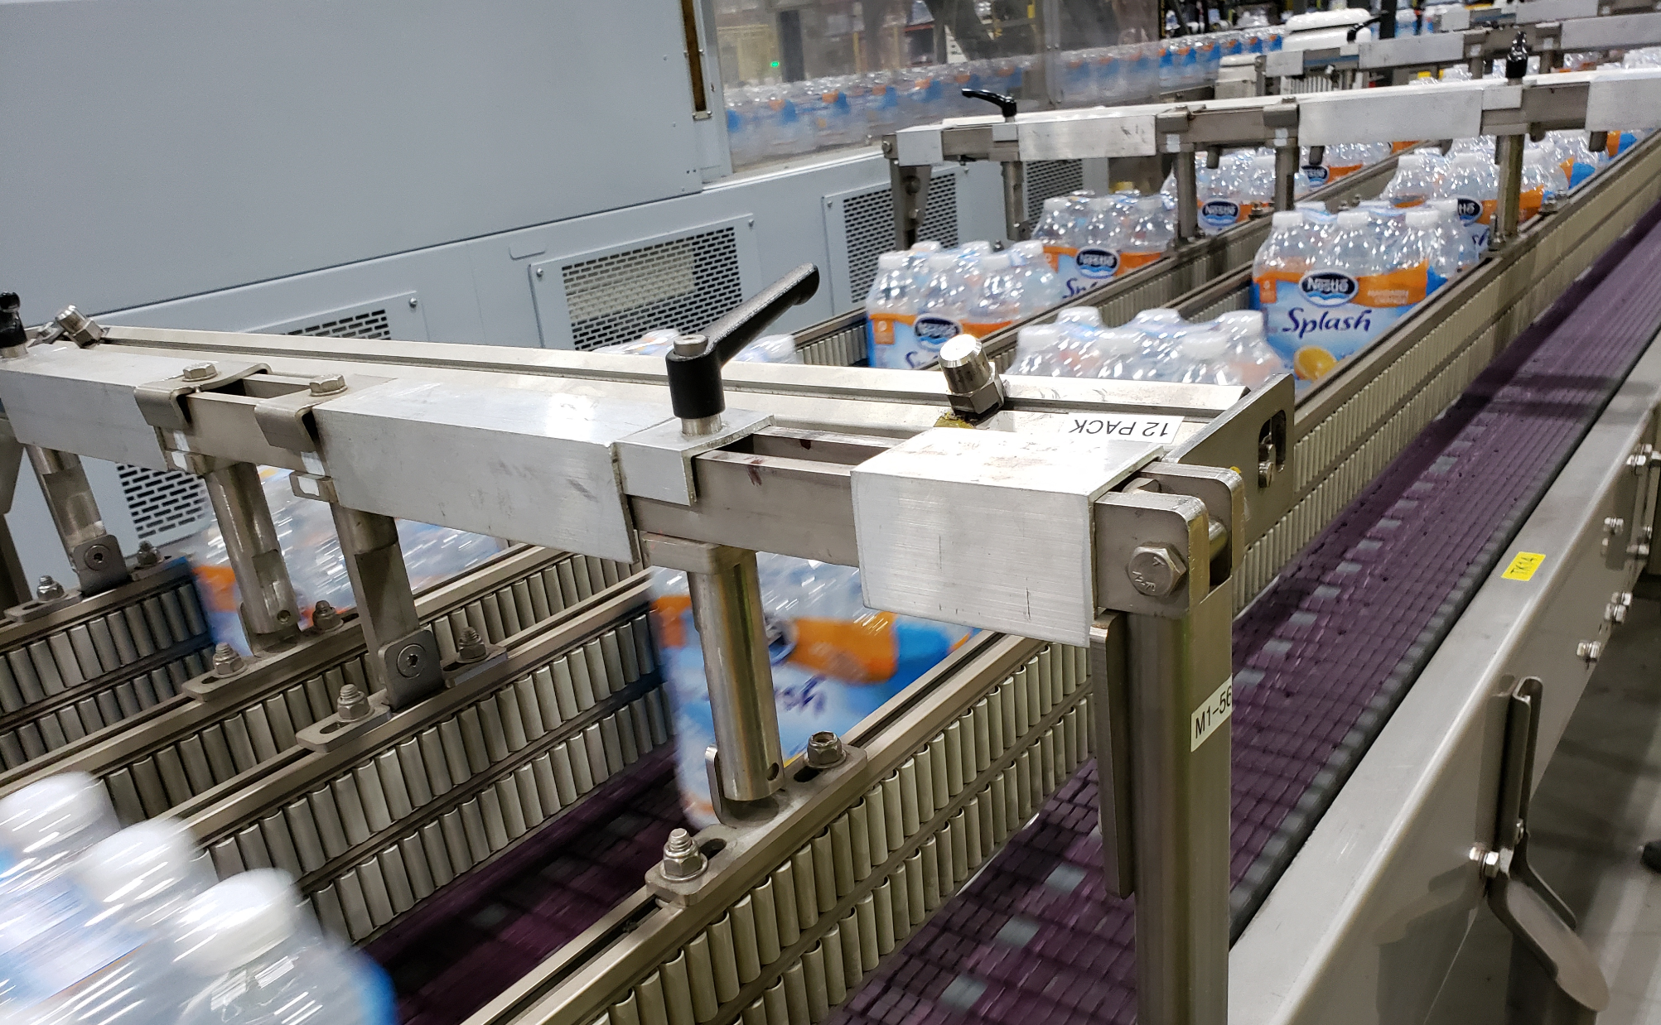
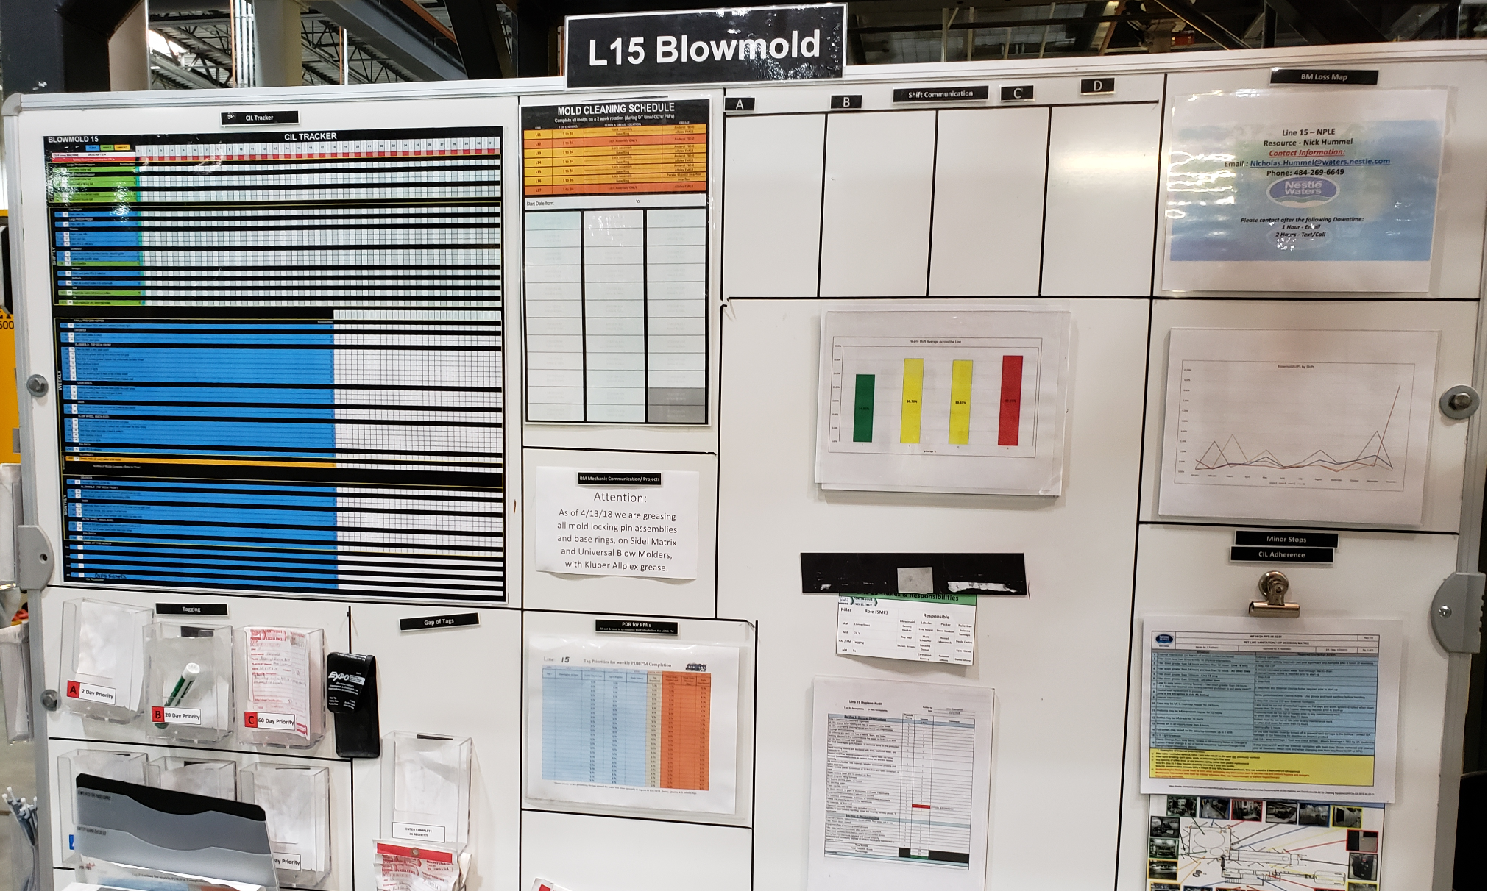
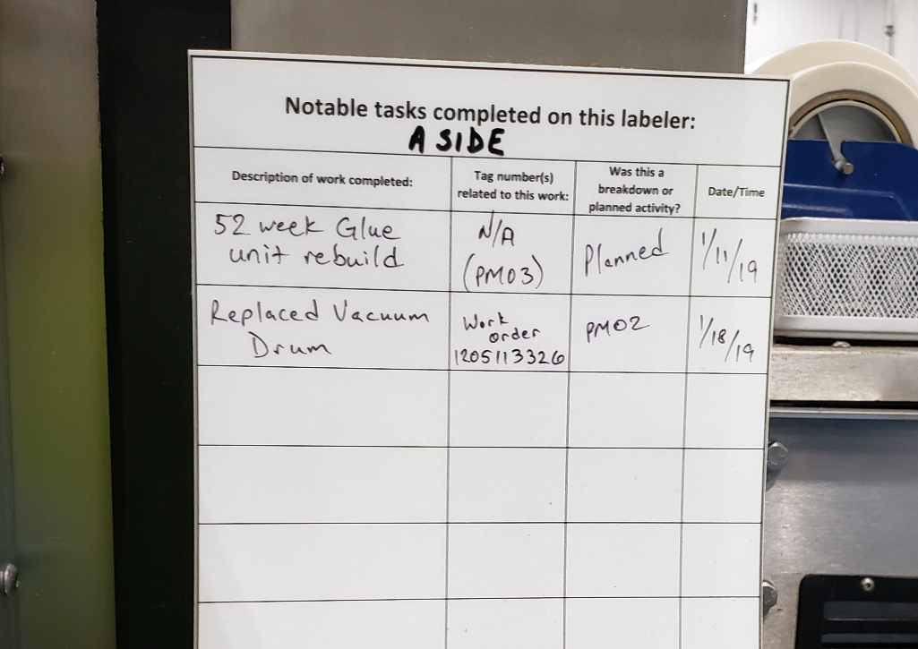
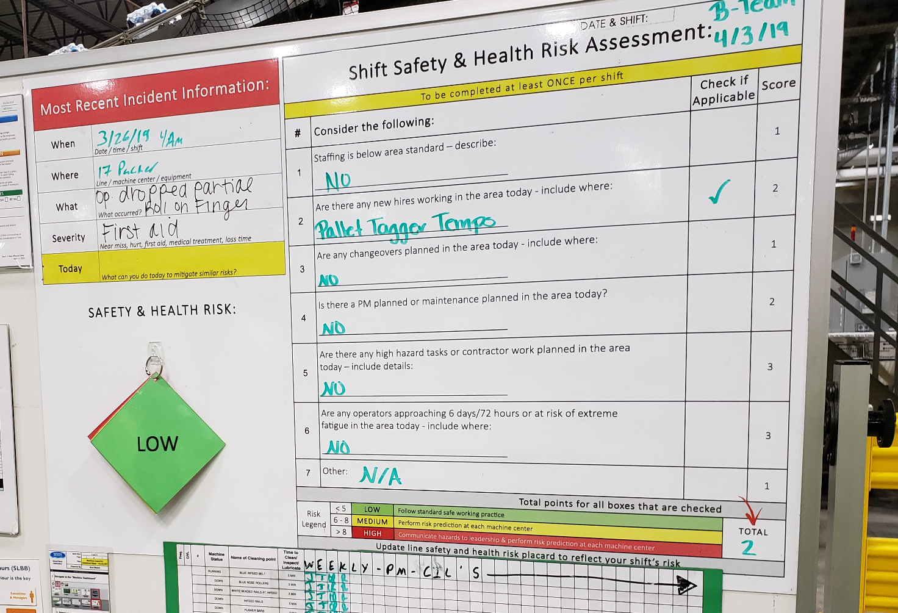
Connected Factory Worker daily work topics
Centerlining
Clean-Inspect-Lubricate
Tagging
Safe Ways of Work
Replace Excel-based checklists
Capture adherent and non-adherent points
Feed KPI to PowerBI
Central & distributed administration
Review instructions
Capture in-standard and out-of-standard situations
Document with photographs
Collect KPIs
Replace paper-based process
Enable oversight on entire factory
Capture dates, priorities
Replace whiteboard process
Capture workplace safety assessment
Collect assessments from multiple work areas of a line
Calculate risk and distribute via push notification

Slide 3
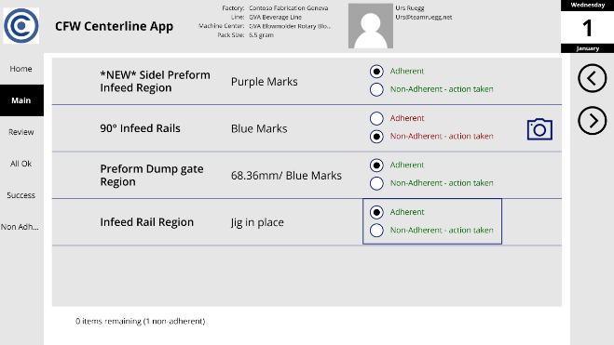
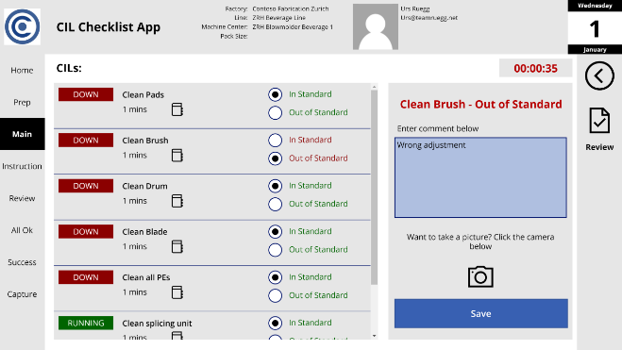
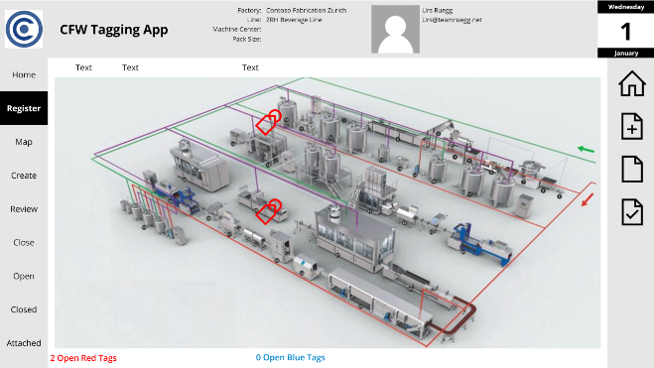
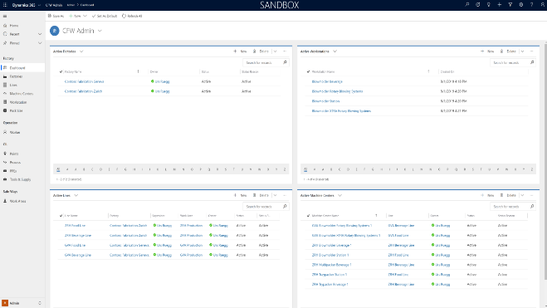
Connected Factory Worker application overview
Centerlining
Clean-Inspect-Lubricate
Tagging
Admin
Mobile app with predefined Centerline checklists for Machine centers, Lines and Factories.
Guided step by step process to capture adherent and non-adherent points
Centralized Reporting
Mobile app with predefined CIL instructions for Machine centers, Lines and Factories.
Guided step by step process to capture (photos) in-standard and out-of-standard situations.
Mobile app visualize and capture tags mapped to Factory and/or Line map locations.
Guided step by step process to capture and manage tags, priorities and actions.
Centralized web app to manage master and processing data across factories, lines and machine centers.
Centralized reporting.

Slide 4
Data Model
Shift
Training Types
Training
Packer Competency
Work Area
Factory
Employees on Shift
Skill Name
Supervisor
(System User)
SLC
Workstation
Skill
Line
Open Tag
Competence
CIL Process
Module
CIL Record
Machine Center
PPE
CIL Point
Completed Module
CIL Tool/Supply
CIL Record Summary
Pack Size
Center Line Adjustment Point
Centerline Record
Centerline Summary

Slide 5
Data Model
Work Area
Factory
Employees on Shift
Supervisor
(System User)
SLC
Workstation
Line
Open Tag
CIL Process
CIL Record
Machine Center
PPE
CIL Point
CIL Tool/Supply
CIL Record Summary
Pack Size
Center Line Adjustment Point
Centerline Record
Centerline Summary

